Slide 1
Database Systems for
Data Science
Final Presentation
Mobile Application Project
Team 5 :-
Ashay Shah, Anvita Rompicharla, Neel Doshi,
Nirav Gori, Niveditha CA, Sudarshan Srinivasan
Notes:
Anvita

Slide 2
ETL (Extraction , Transformation, Loading)
Notes:
Anvita

Slide 3
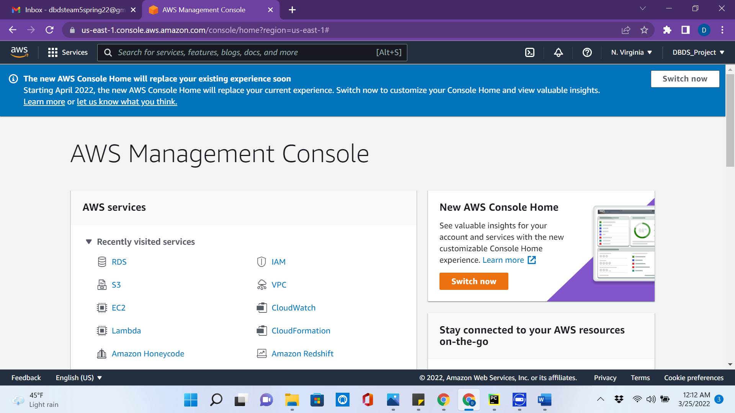
AWS Setup - Created an AWS free account named DBDS_Project
Notes:
Anvita

Slide 4
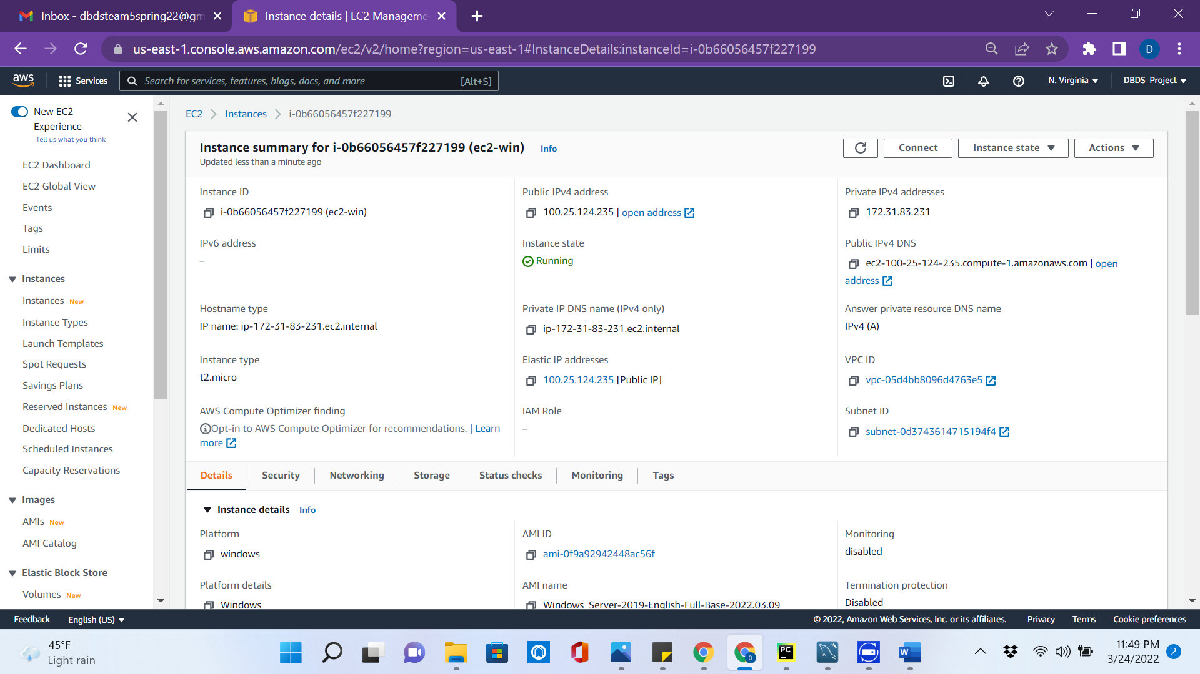
Launched an EC2 Instance named ec2-win
Notes:
Anvita

Slide 5
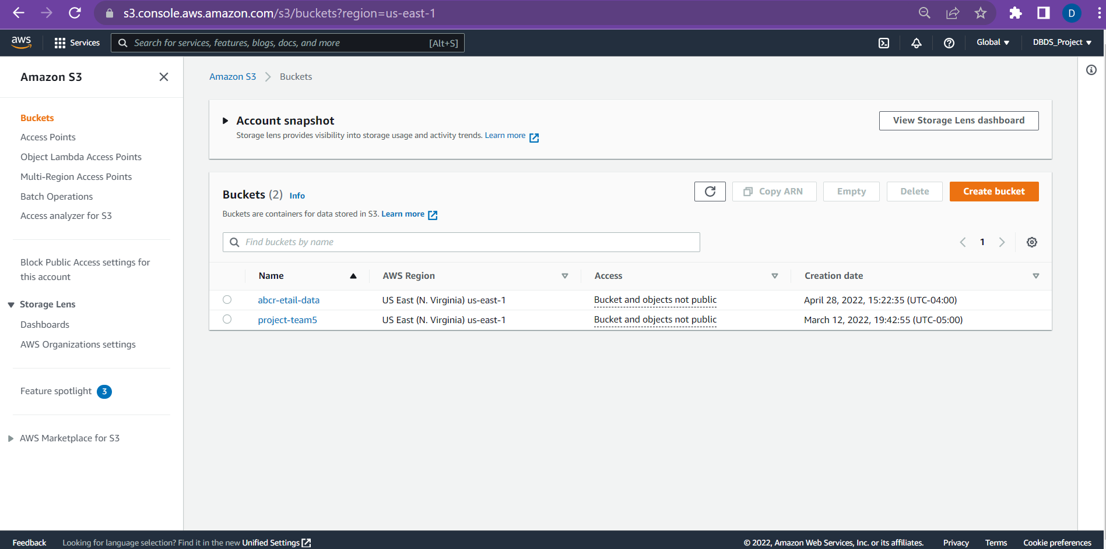
Created a S3 buckets for Instacart and ABC Retail
Notes:
Anvita

Slide 6
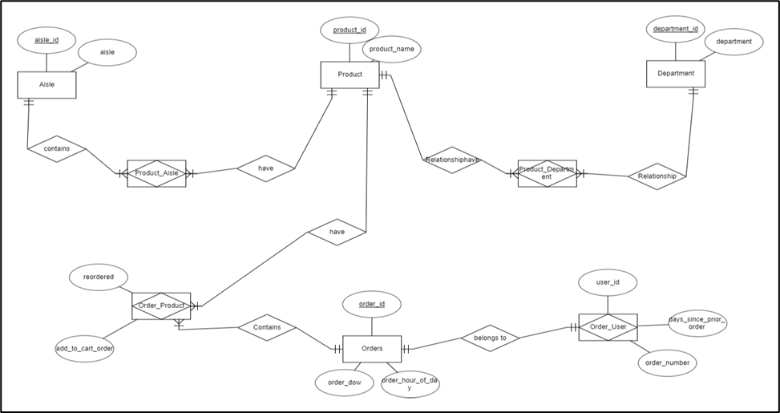
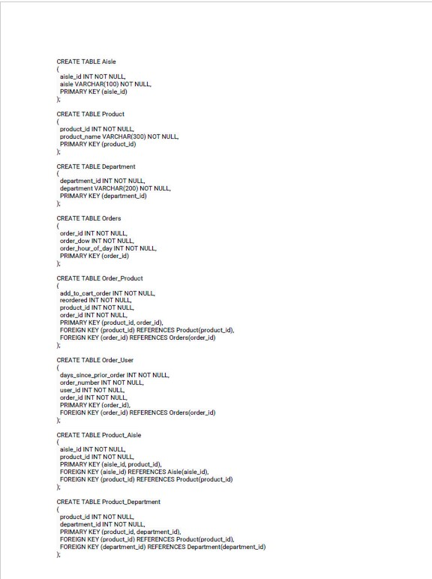
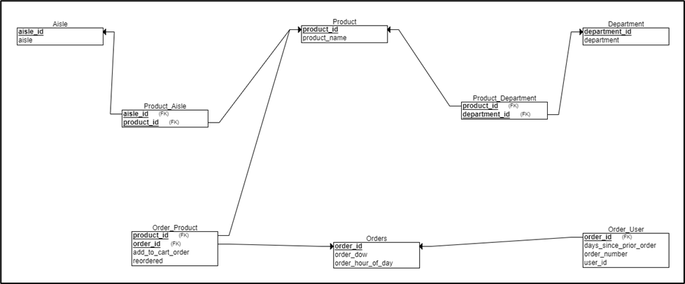
Instacart Data as Conceptual, Relational and Logical Model
Notes:
Anvita

Slide 7
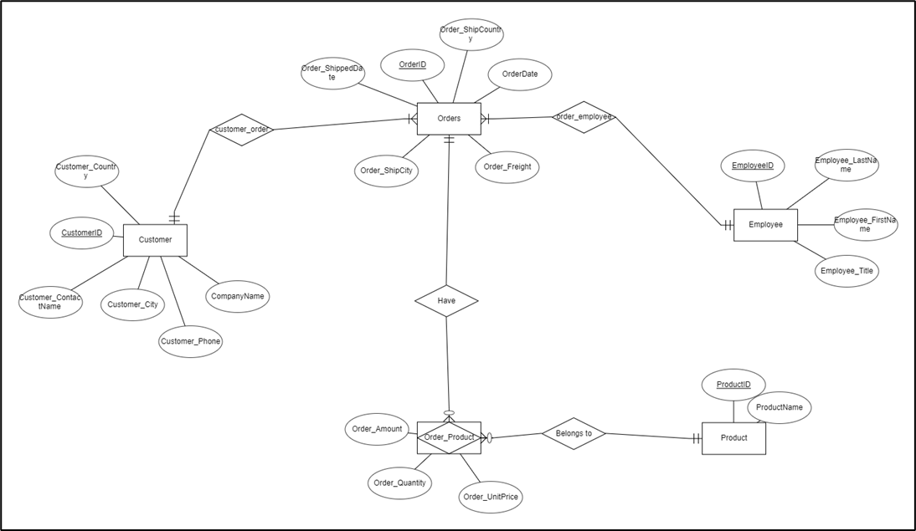
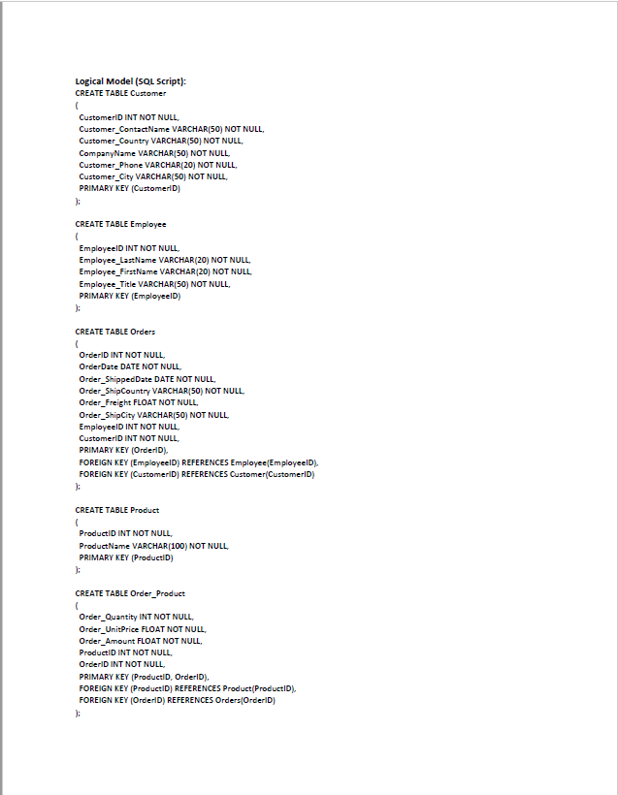
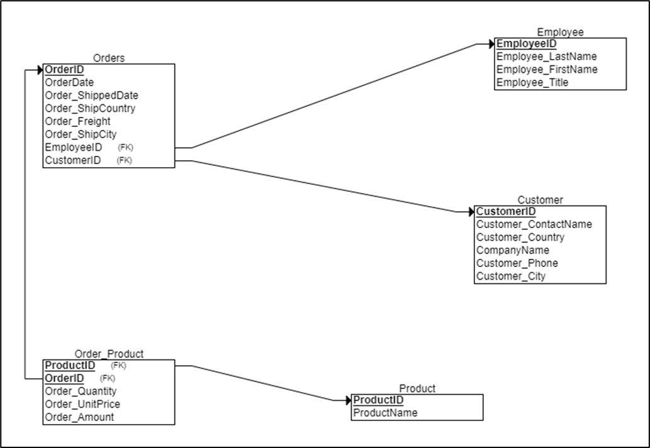
ABC Retail Data as Conceptual, Relational and Logical Model

Slide 8
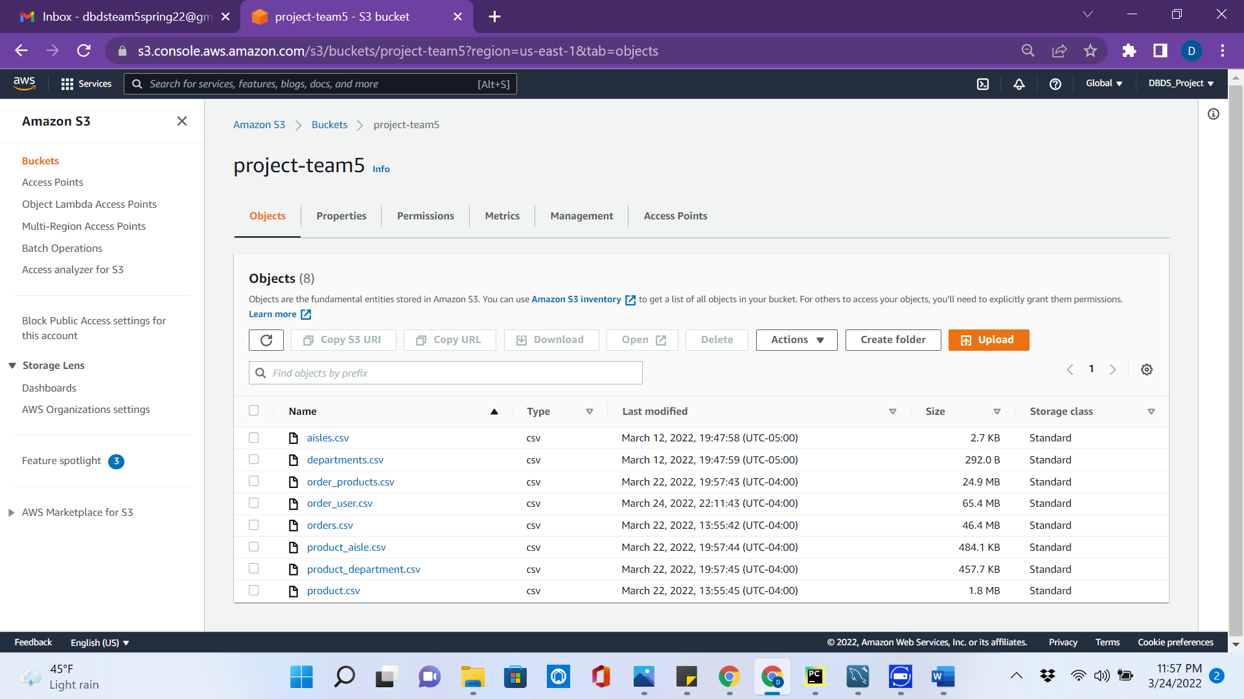
Uploaded Normalized Instacart Data to S3
Notes:
Anvita

Slide 9
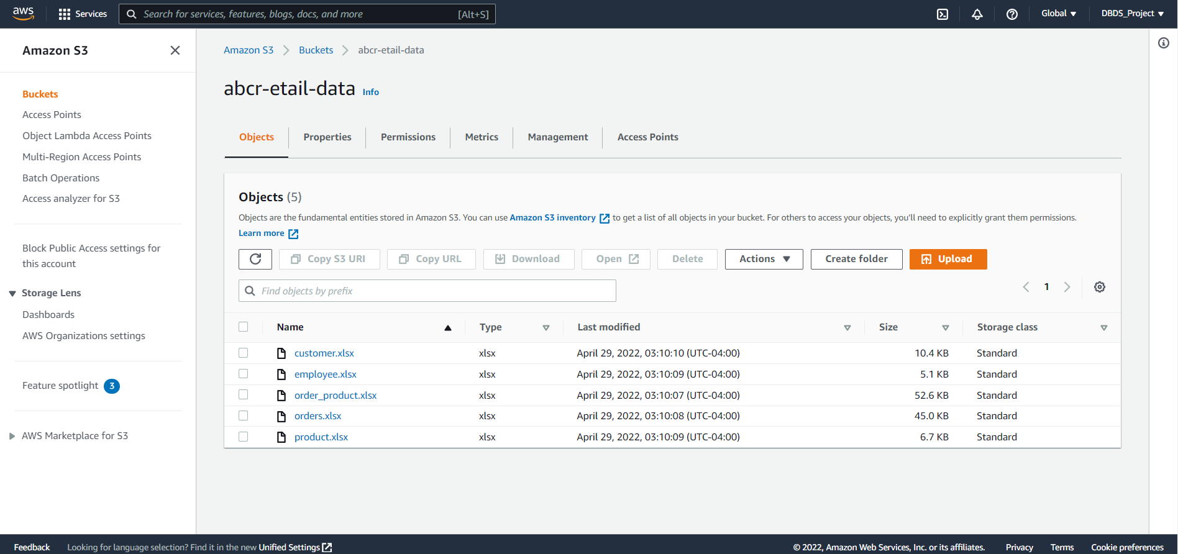
Uploaded Normalized ABC Retail Data to S3

Slide 10
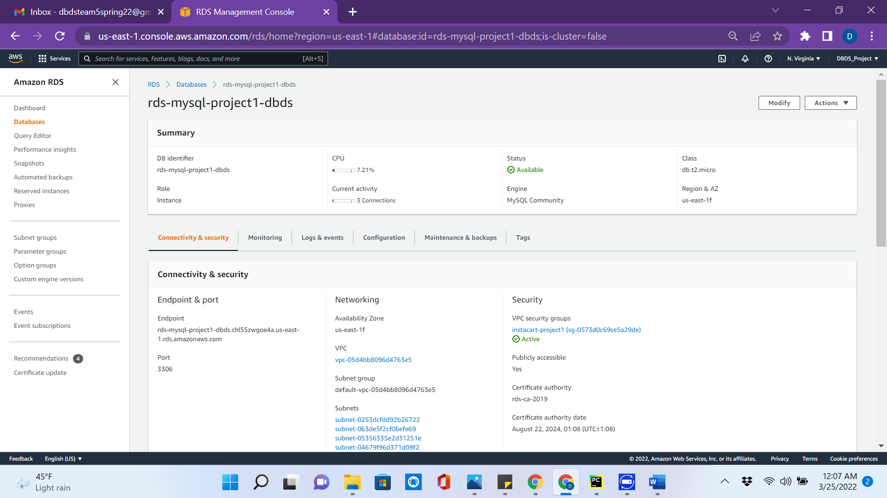
Started an AWS RDS MySQL Instance
Notes:
Anvita

Slide 11
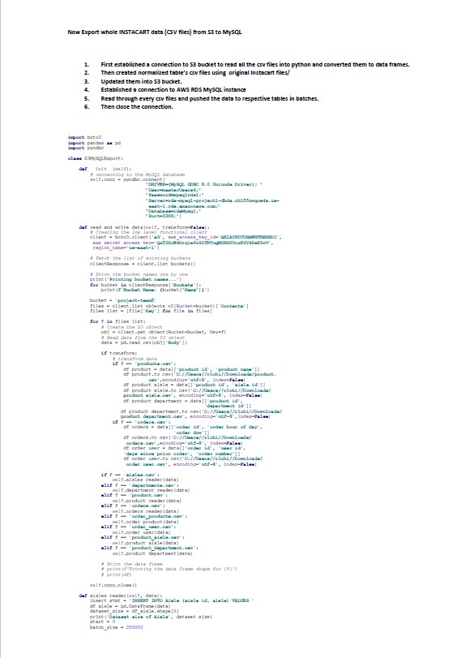
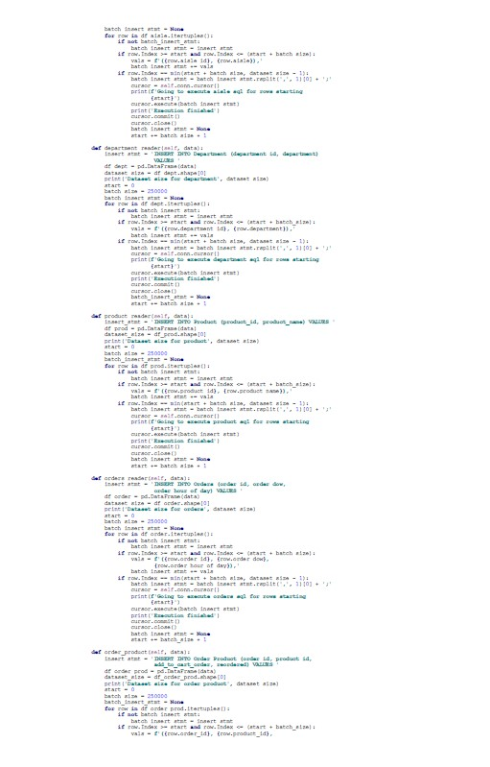
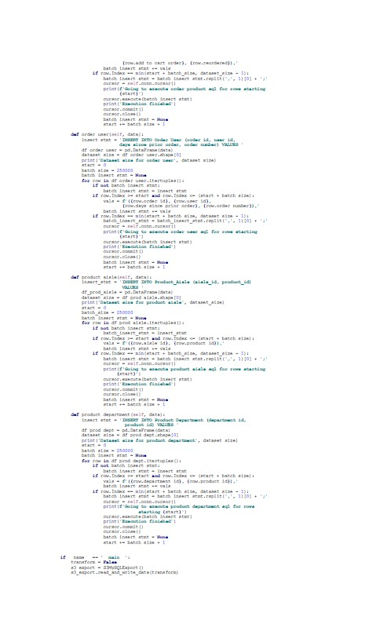
Exporting Data from S3 to MySQL using ODBC connection
Notes:
Anvita

Slide 12
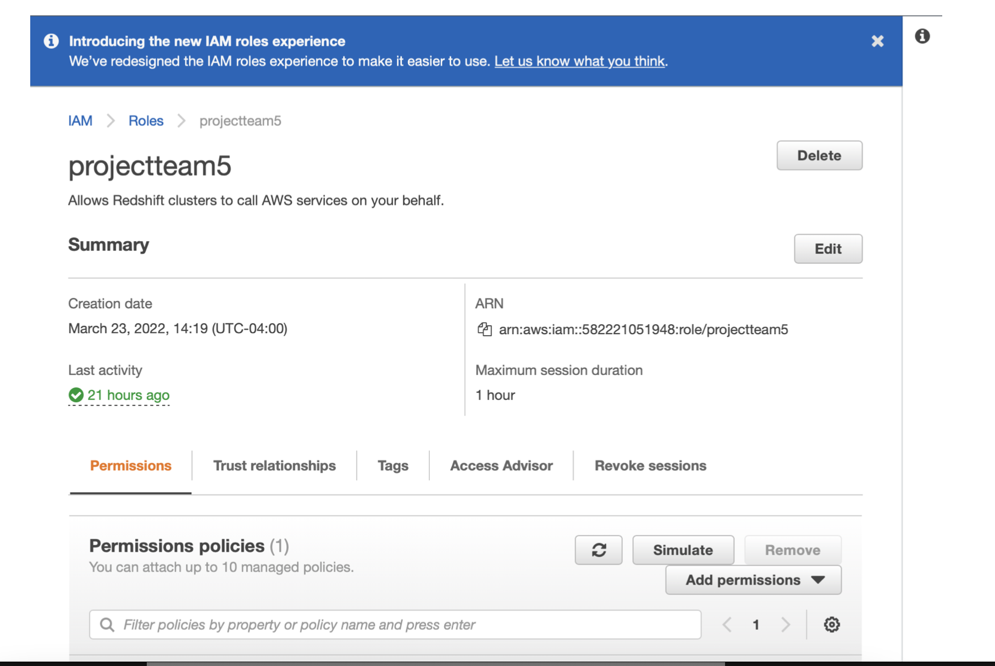
IAM - ROLE CREATION - projectteam5
Notes:
Niv

Slide 13
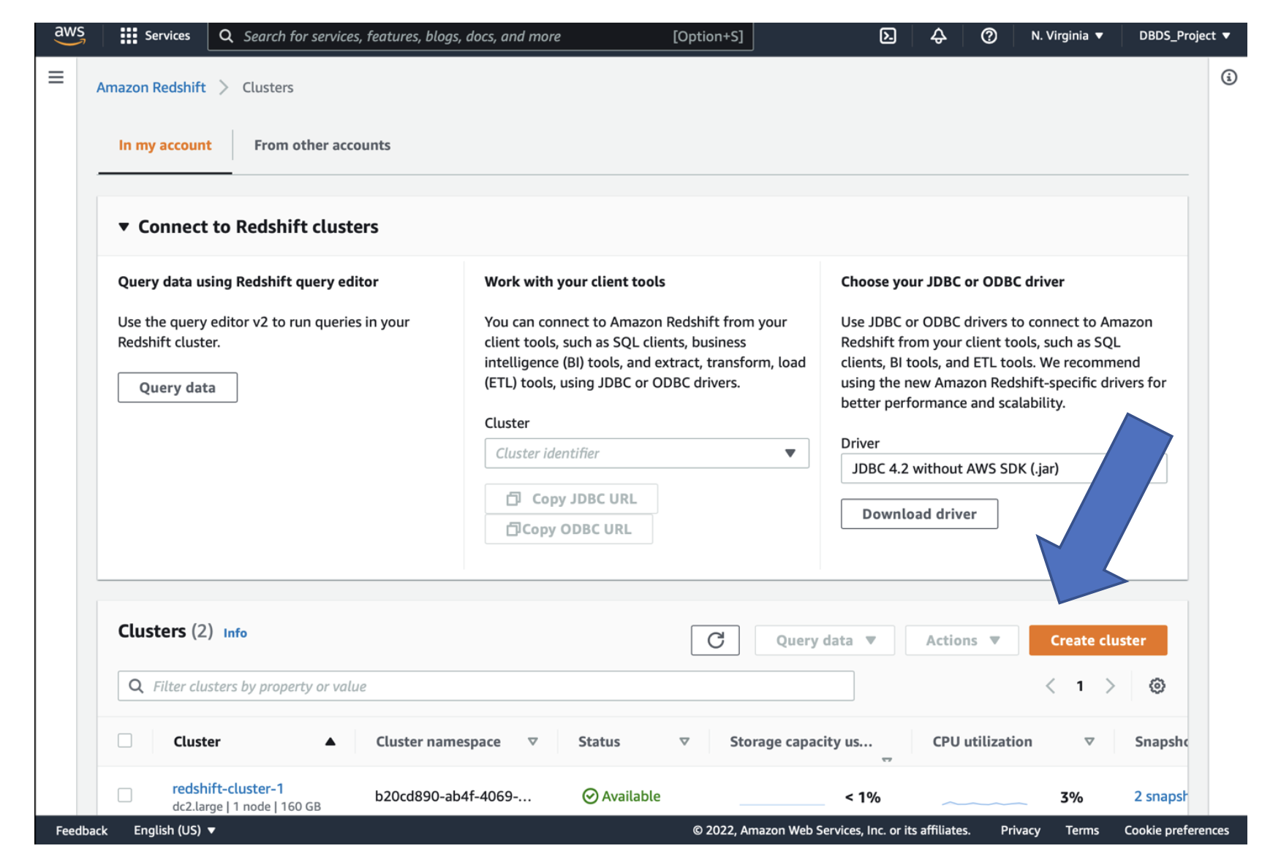
Started a Redshift Instance
Notes:
Niv

Slide 14
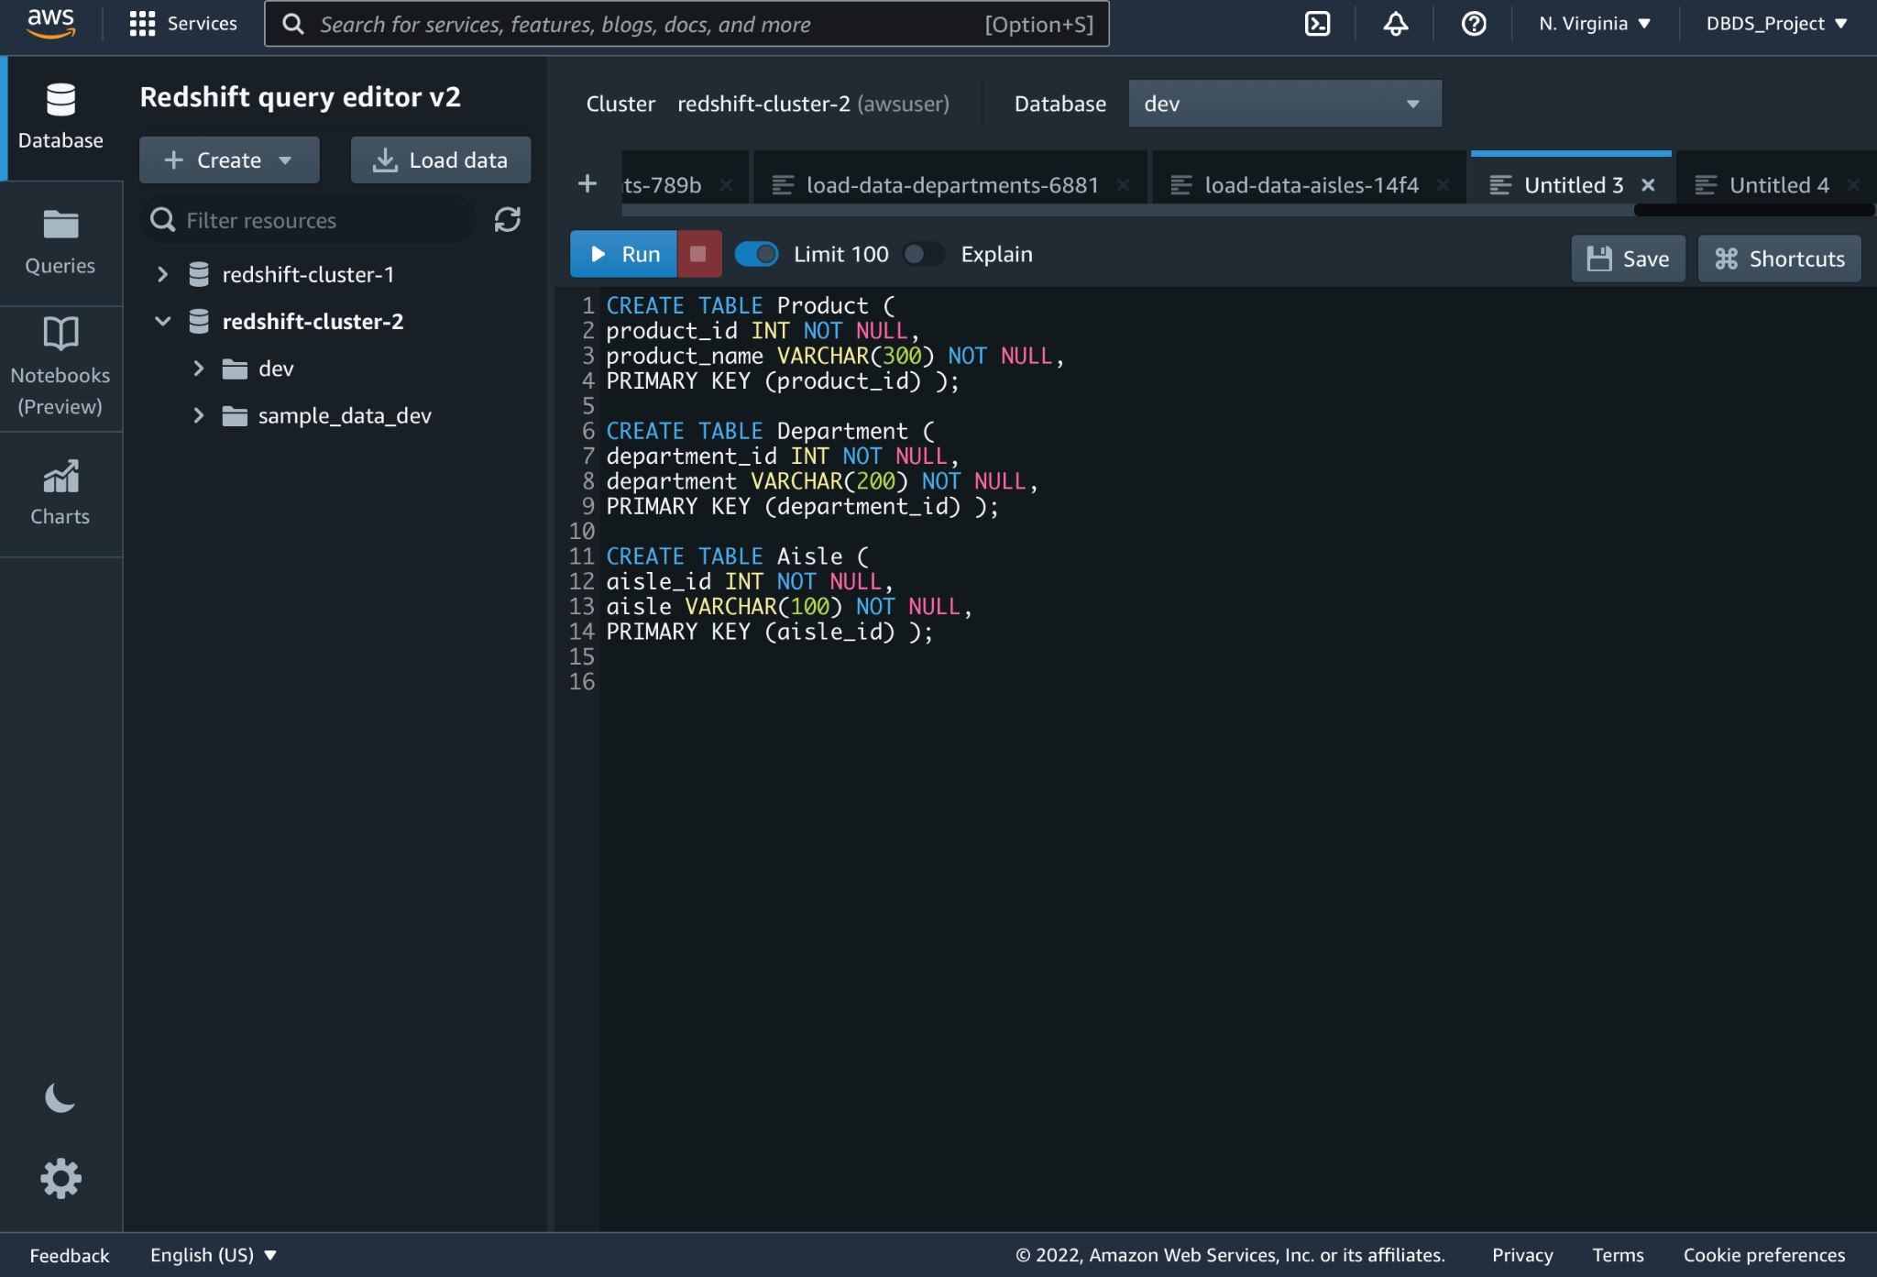
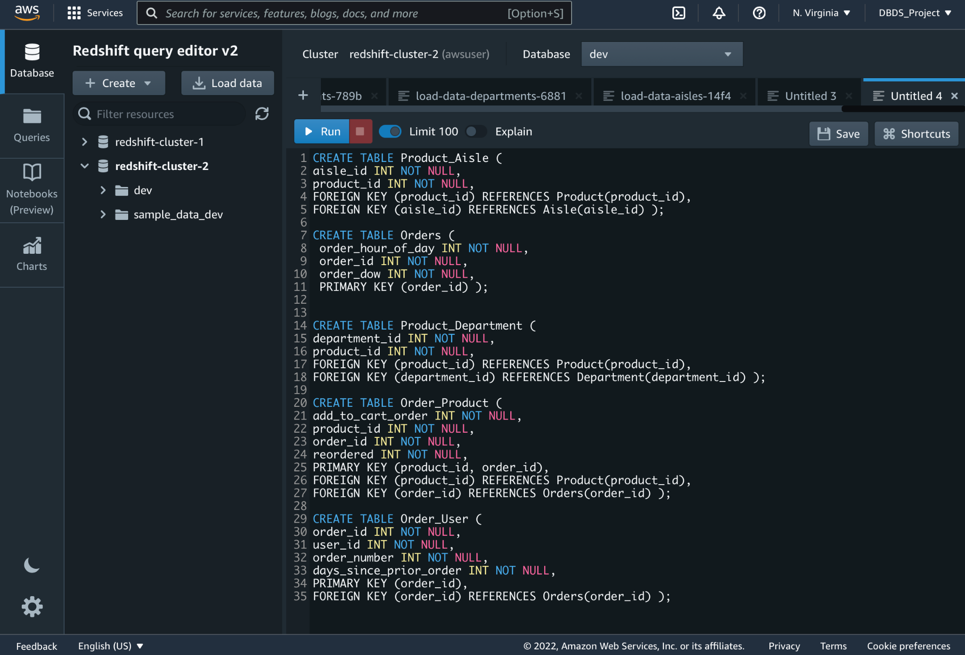
S3 to Redshift - Table Creation
Notes:
Niv

Slide 15
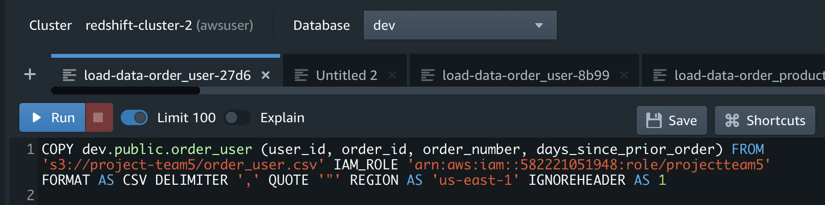
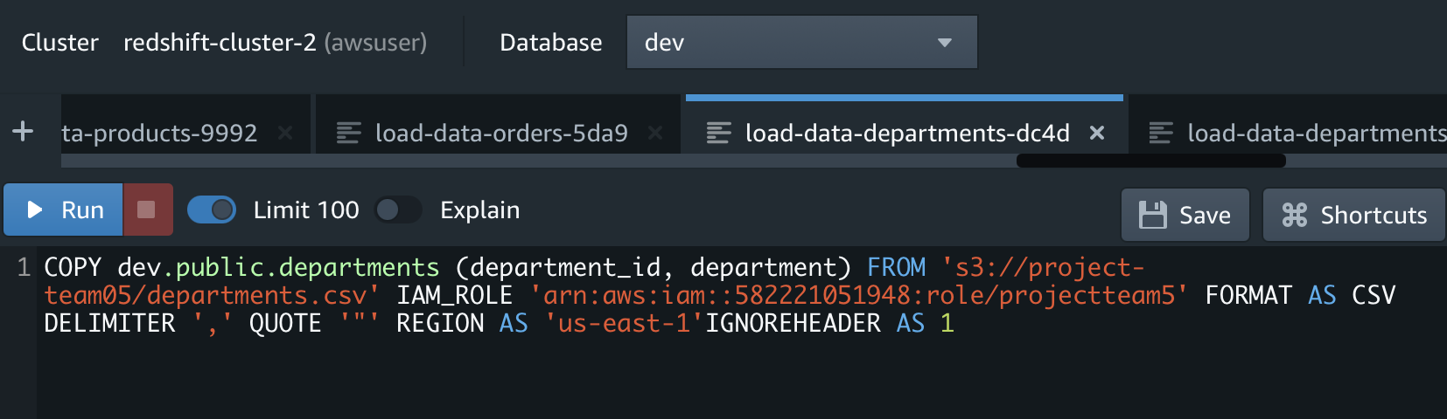
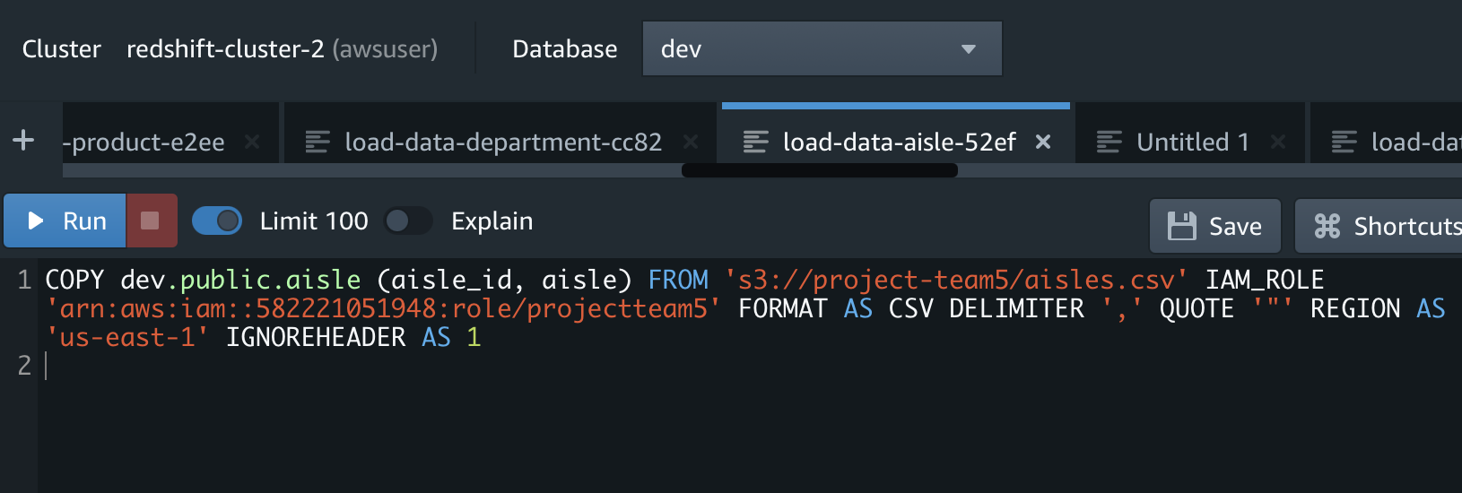
Export Data from S3 to Redshift using - COPY function
Notes:
Niv

Slide 16
2. Mobile Application Component + Design
Notes:
Ashay, Nirav

Slide 17
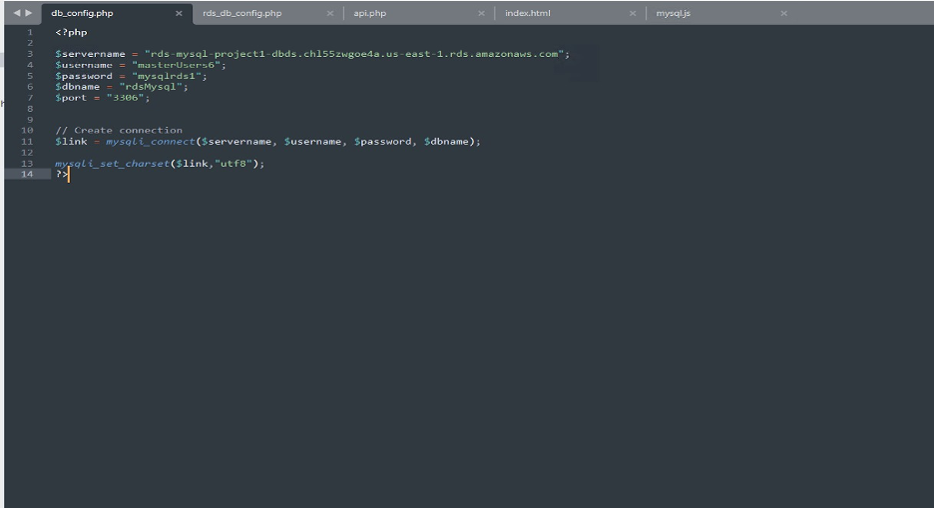
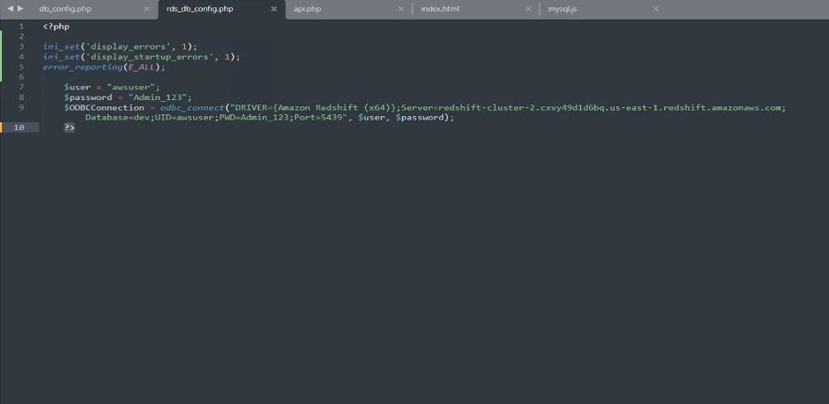
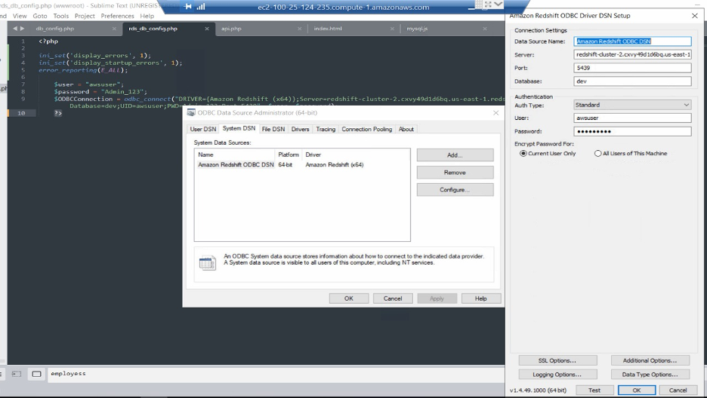
PHP APIs for Configuration of MySQL and RedShift Databases
Notes:
Ashay, Nirav

Slide 18
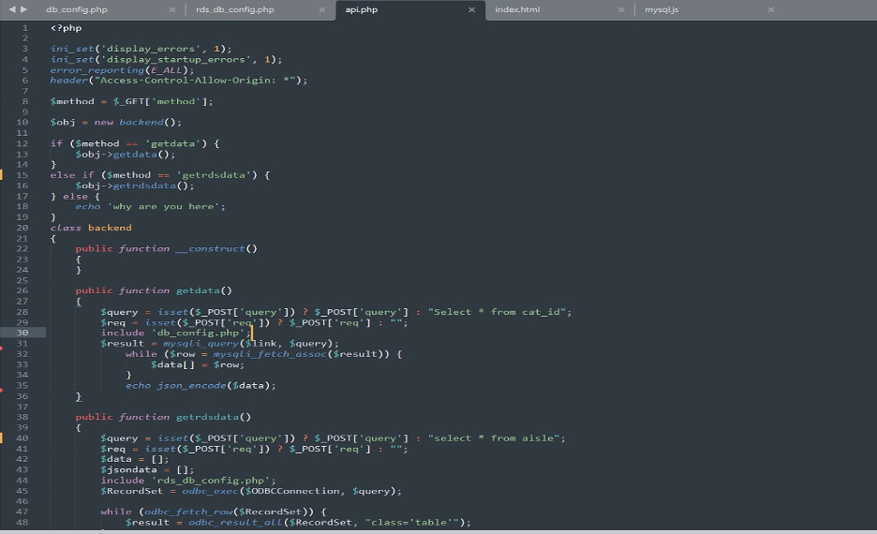
Main API Script
Notes:
Ashay, Nirav

Slide 19
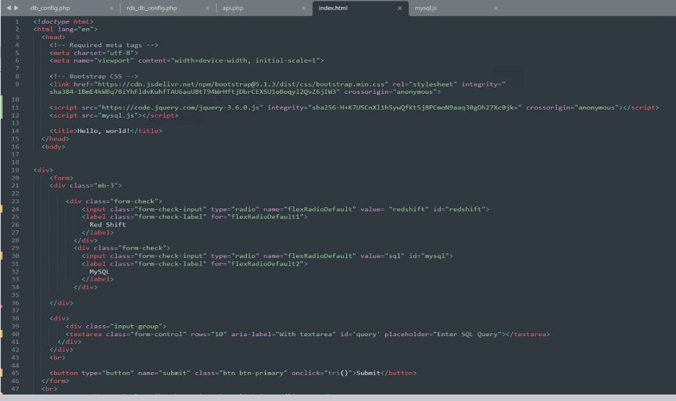
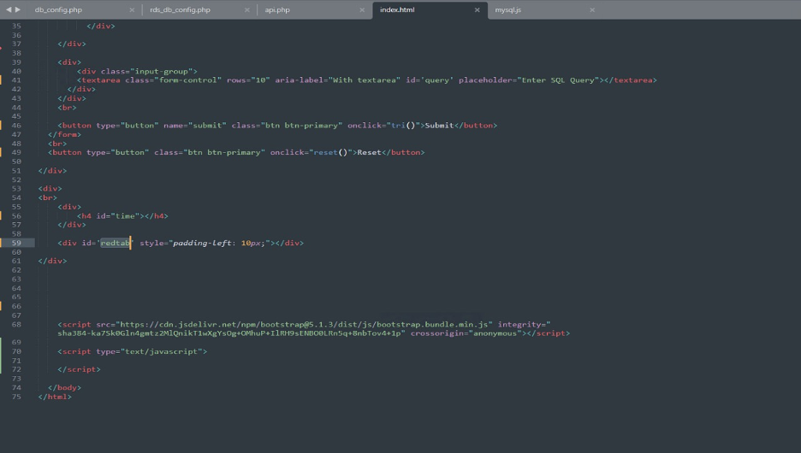
Front End using HTML/CSS, Bootstrap
Notes:
Ashay, Nirav

Slide 20
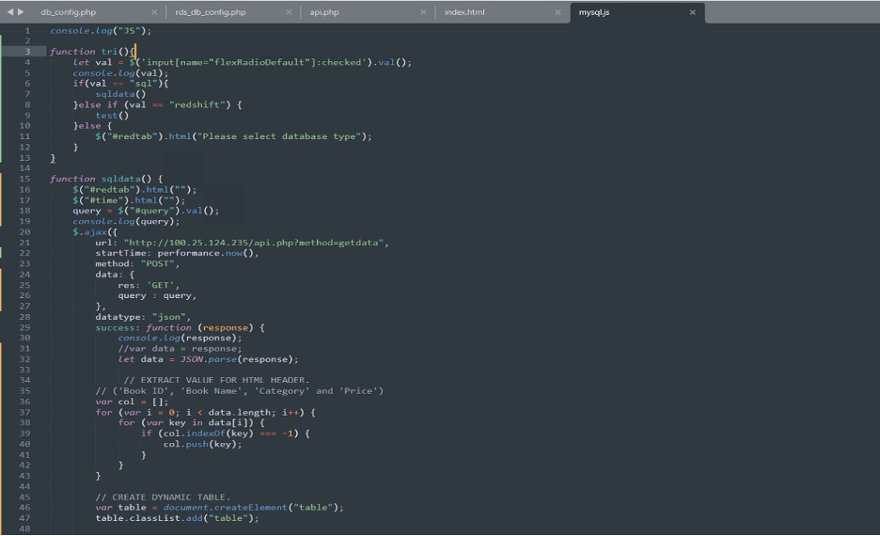
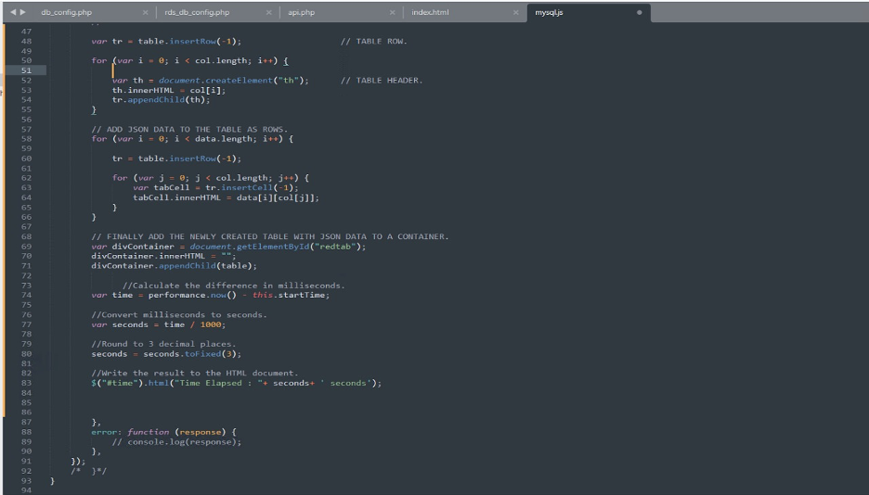
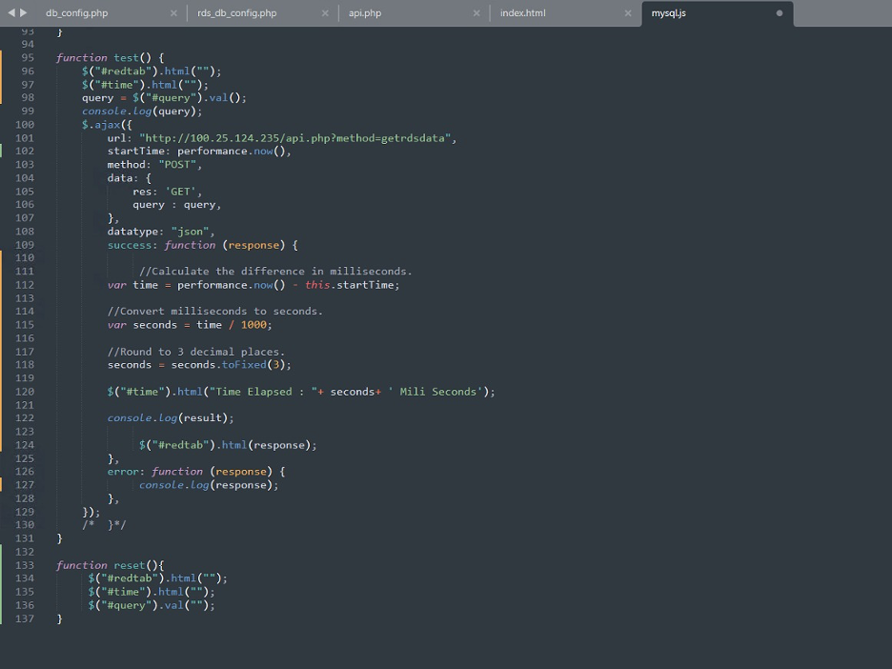
JS,AJAX Script to call the API on any action on Front End
Notes:
Ashay, Nirav

Slide 21
Mobile Application
+ Live Demo
Our actual work!!!

Slide 22
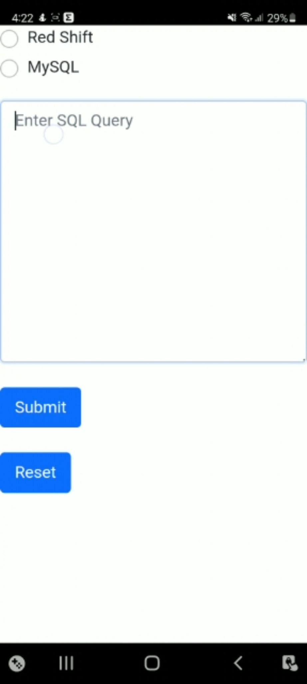
OUR ANDROID APP
Two radio buttons for selecting MySQL and RedShift
Textbox to take in the SQL query
Submit button to get data from database
Reset Button
PROTOTYPE
Place your screenshot here
Notes:
Neel

Slide 23
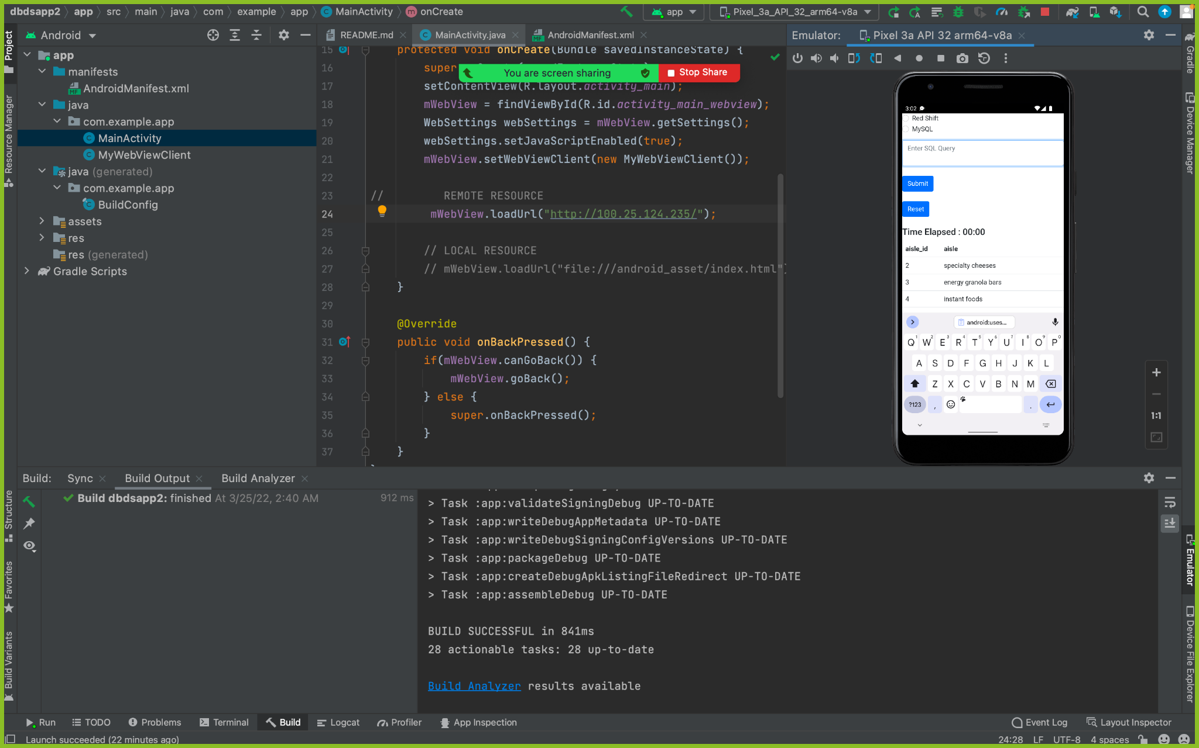
Integration of the Android Mobile Application
Notes:
Neel

Slide 24
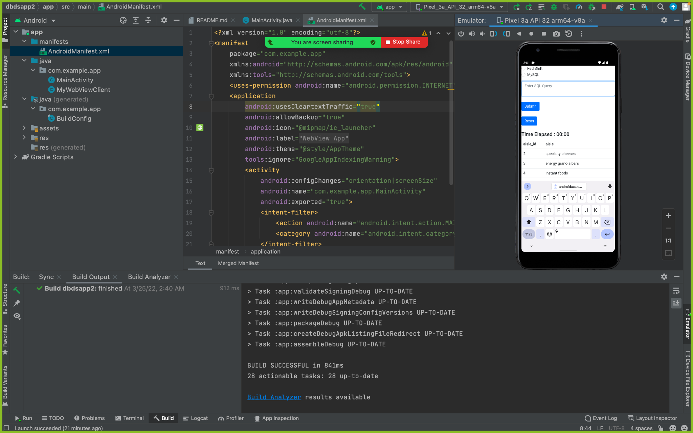
Integration of the Android Mobile Application - RESULT
Notes:
Neel

Slide 25
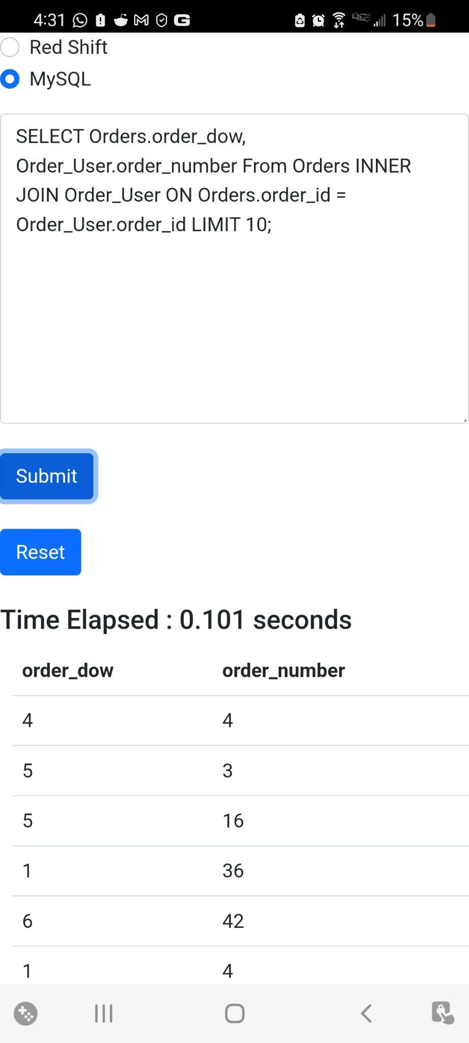
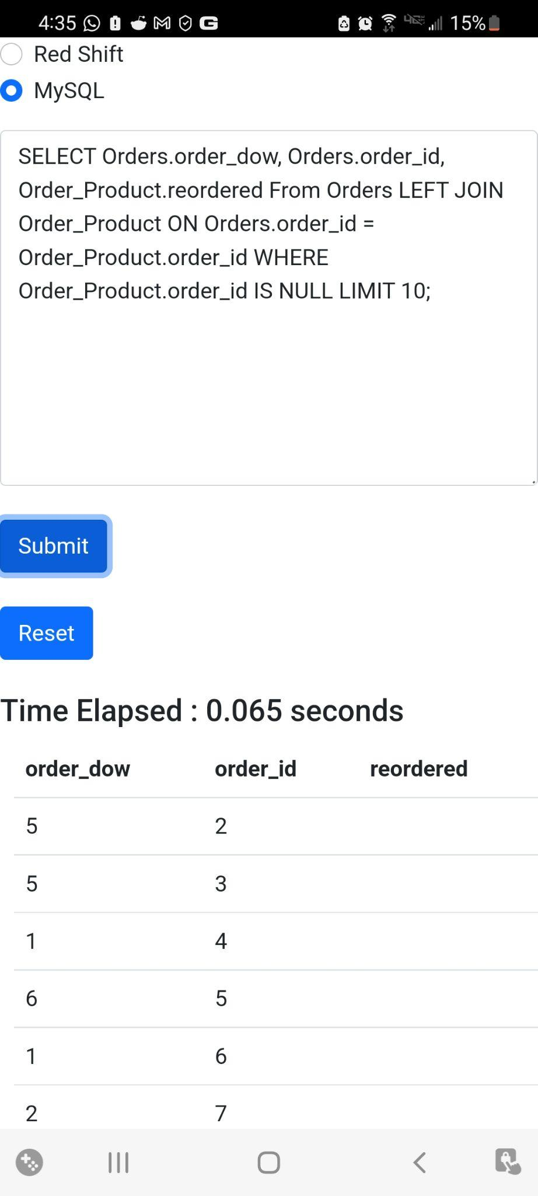
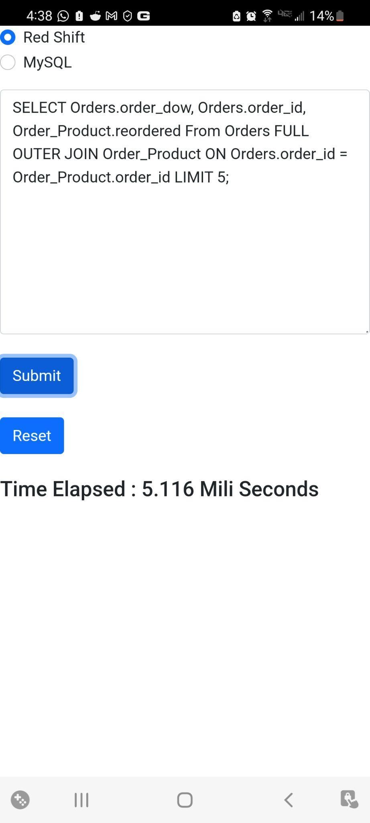
OUTPUT SCREEN SHOTS
Notes:
New Screenshots!!!!

Slide 26

Working Mobile Application - Result

Slide 27
Challenges Faced
Exporting bulk data from S3 to MySQL
Selecting Windows vs Linux EC2 Instance
Connectivity issues with AWS and the app backend
Notes:
Sudarshan

Slide 28
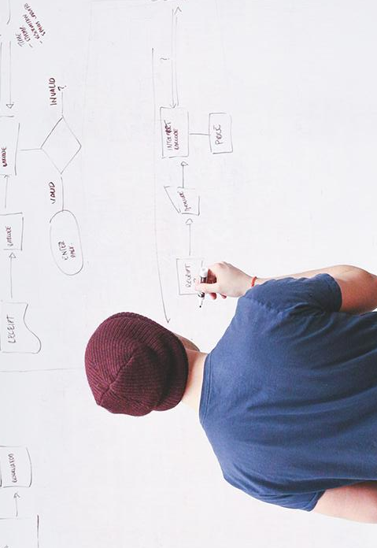
THANK YOU!
Any questions?

Slide 29
THANK YOU!
Any questions?

Slide 30
Working Mobile Application - Result
Notes:
Neel

